Slide 1

Obstacle Course Game
Daniel Foth

Slide 2
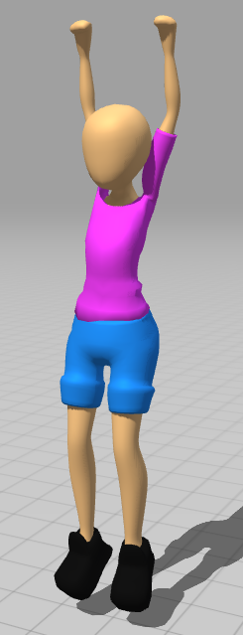
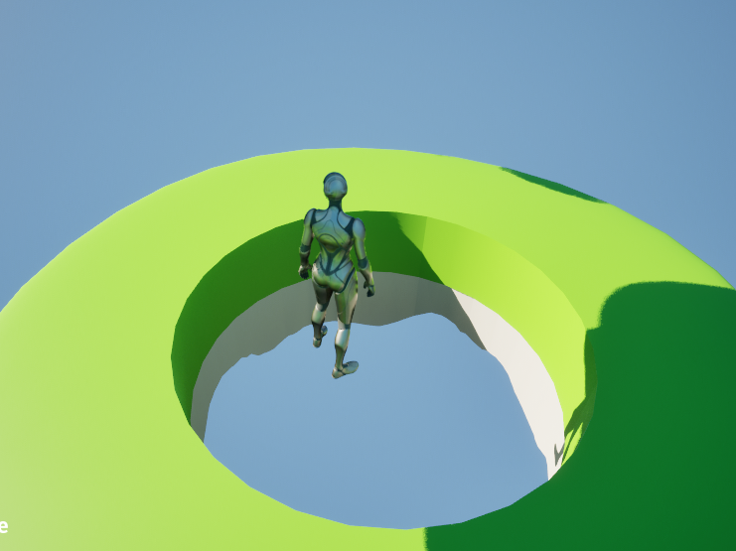
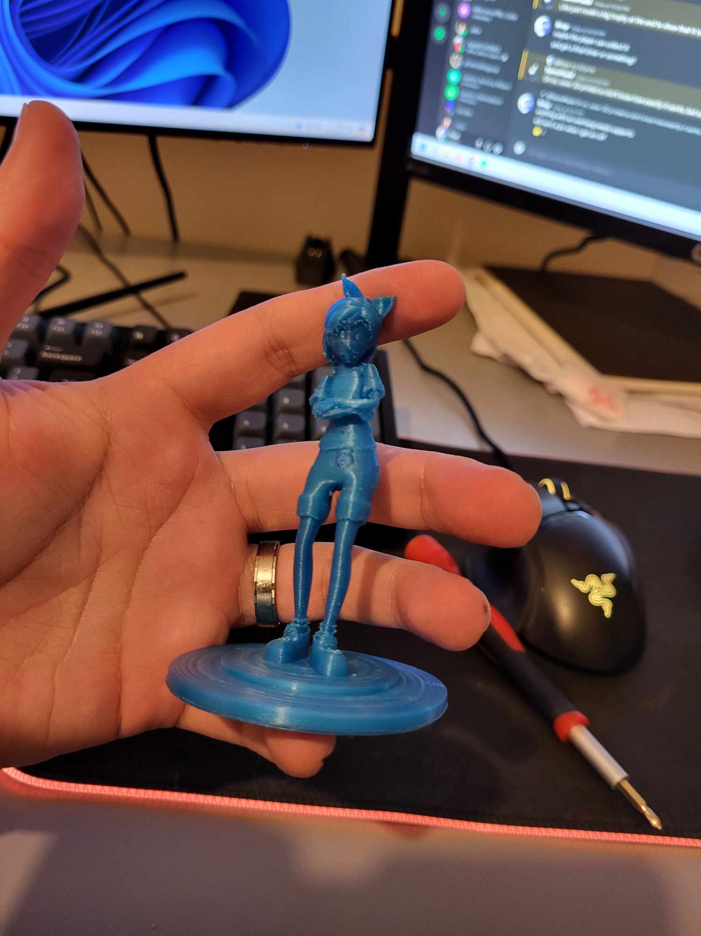
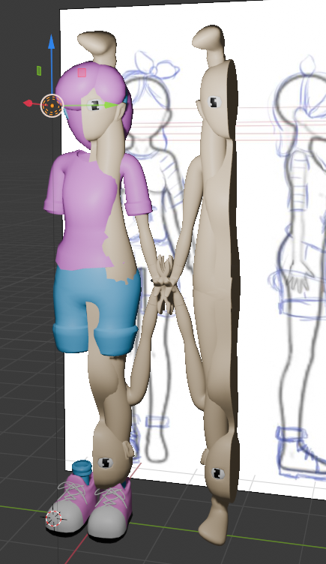
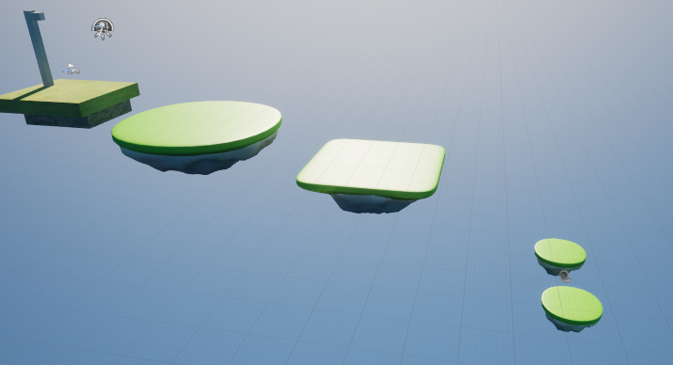
What's Changed
Done
Re-branded to Descent
More Audio
Menus – Main/Controls/Options
Camera Angle
Balancing & Finishing Touches
Added more to the bottom of the hole
Icons for Bars
HUD boarder for falling too fast
Outstanding Issues
Broke controller movement
Options Menu Defaults behave poorly
Scrapped Features
Collectable Power Ups
Obstacles

Slide 3
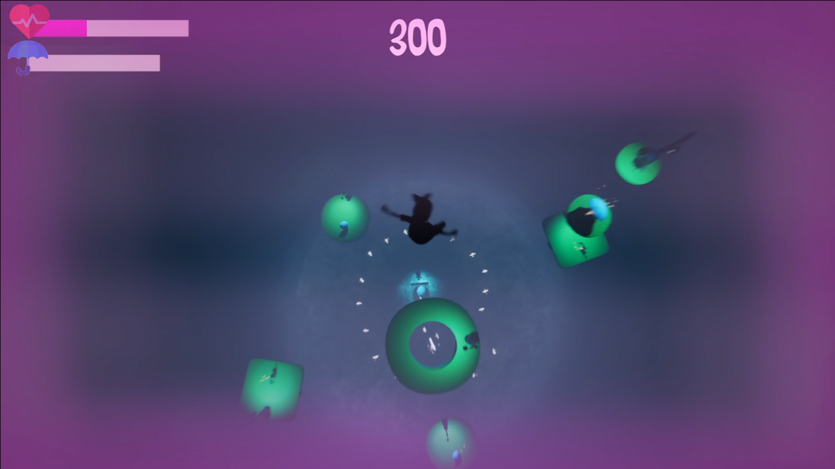
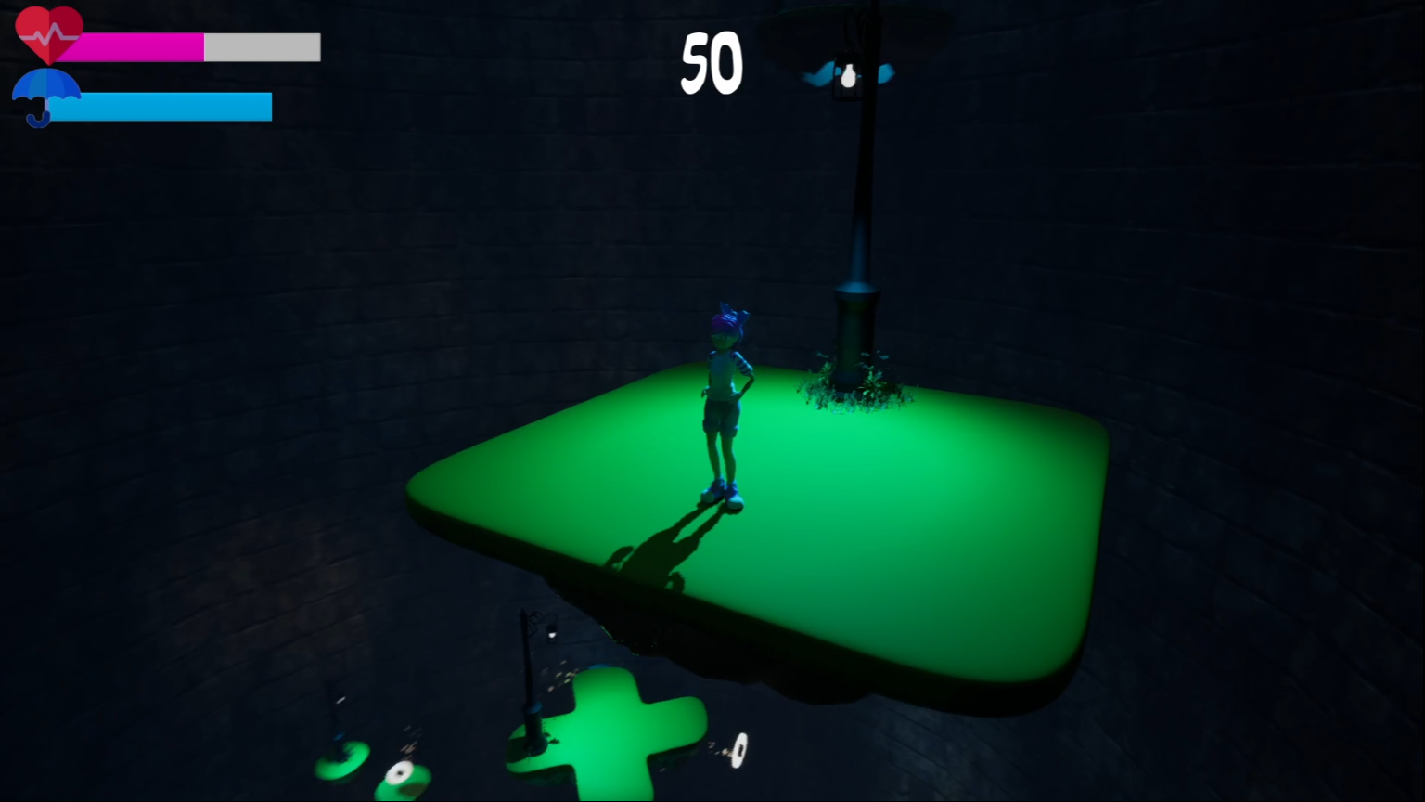
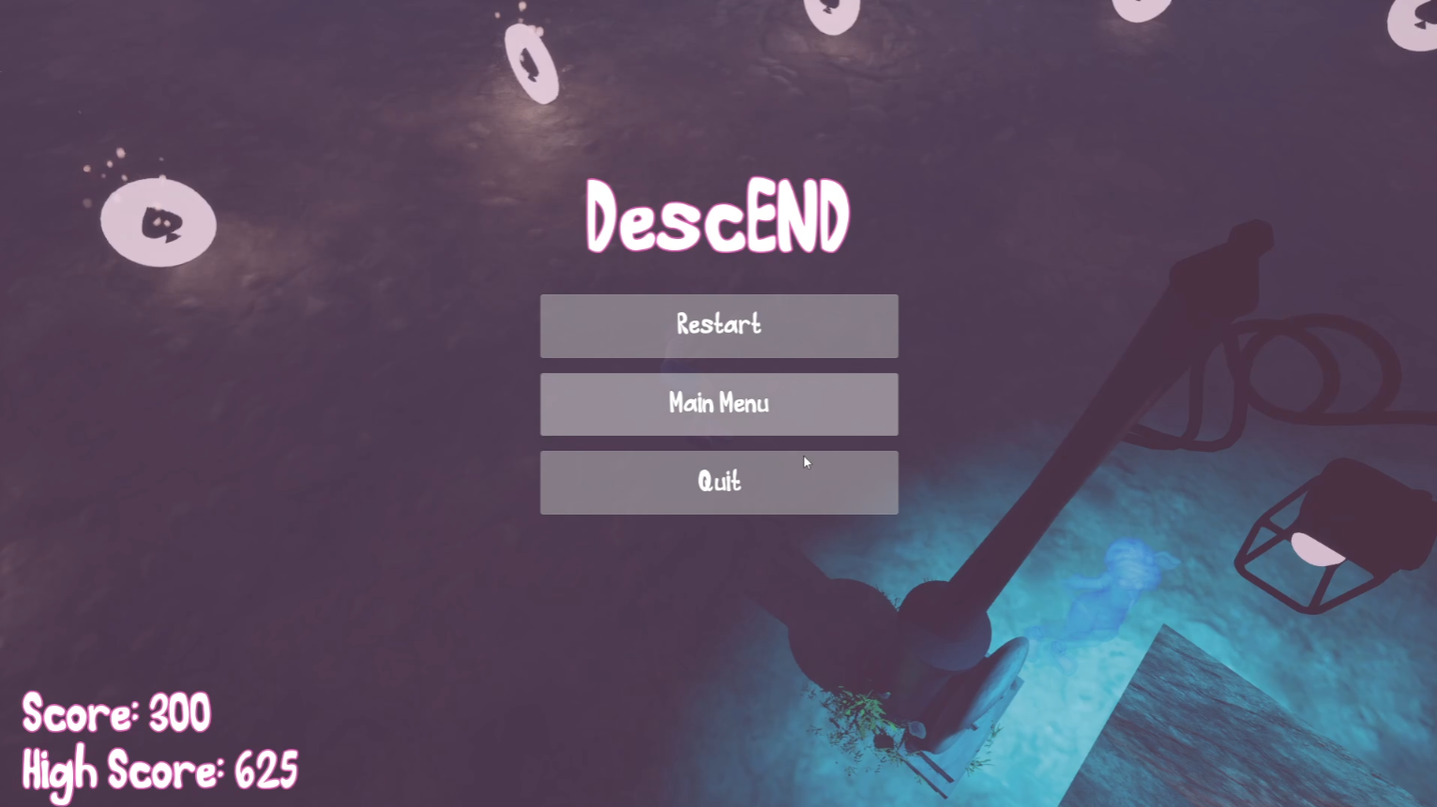
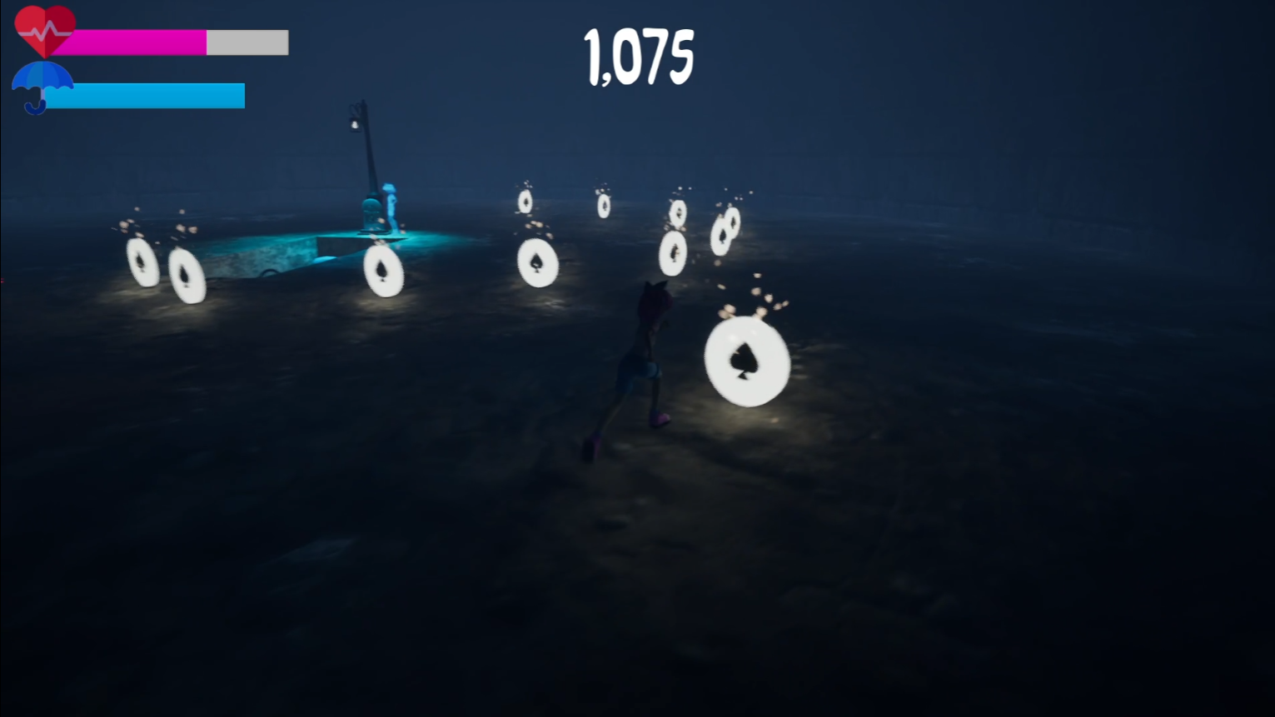
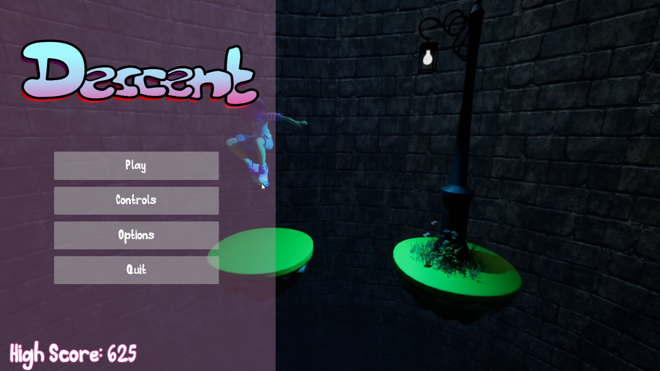
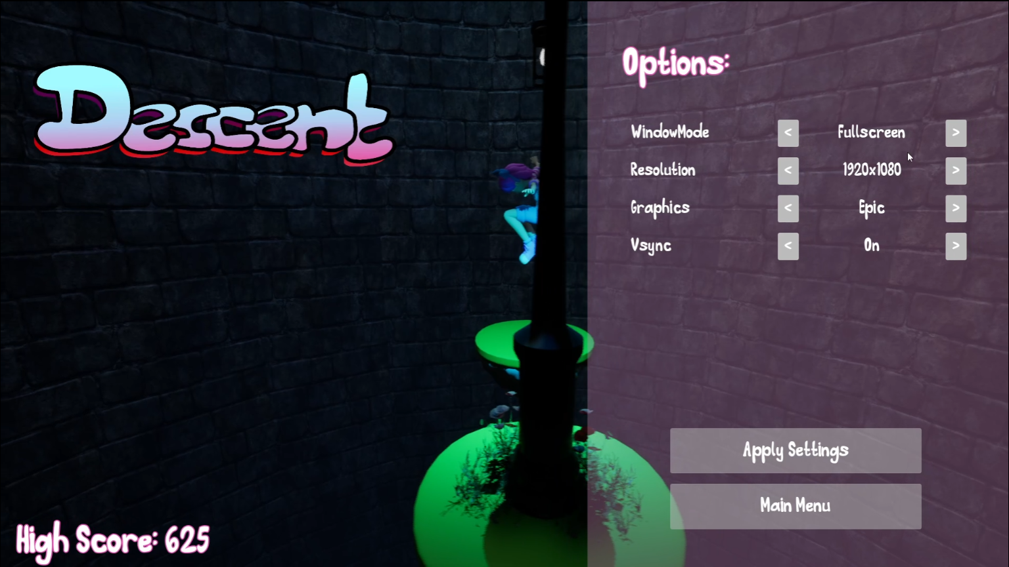
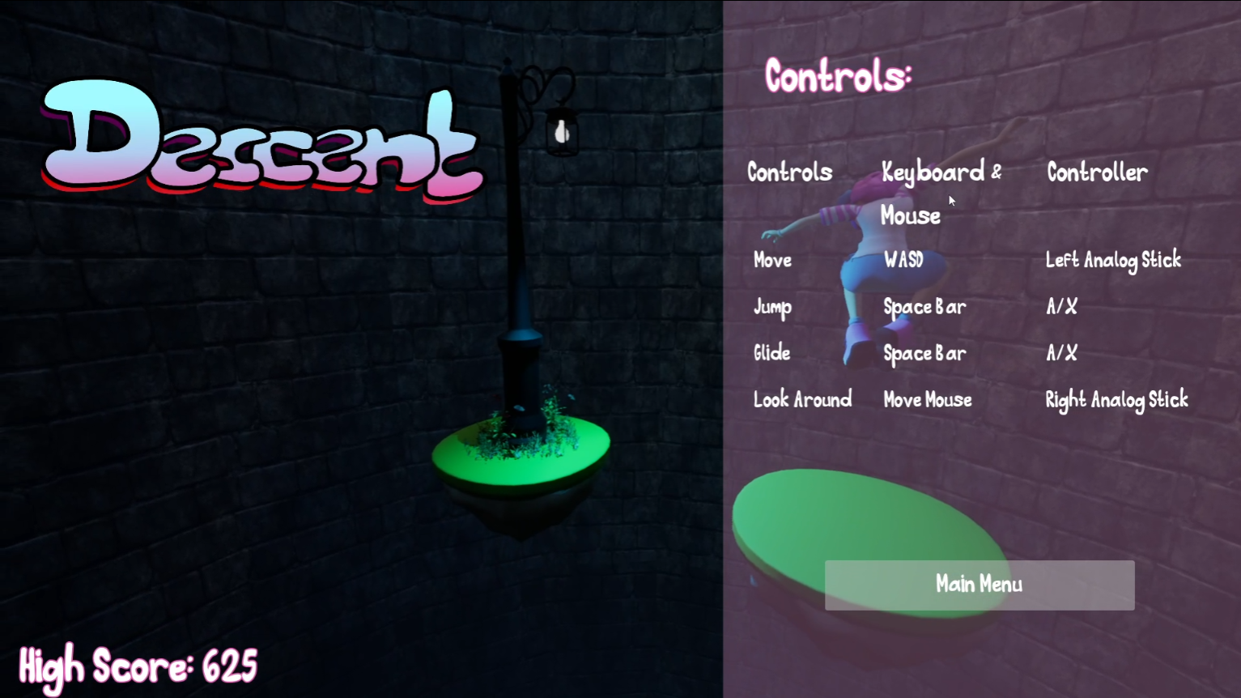
Design

Slide 4
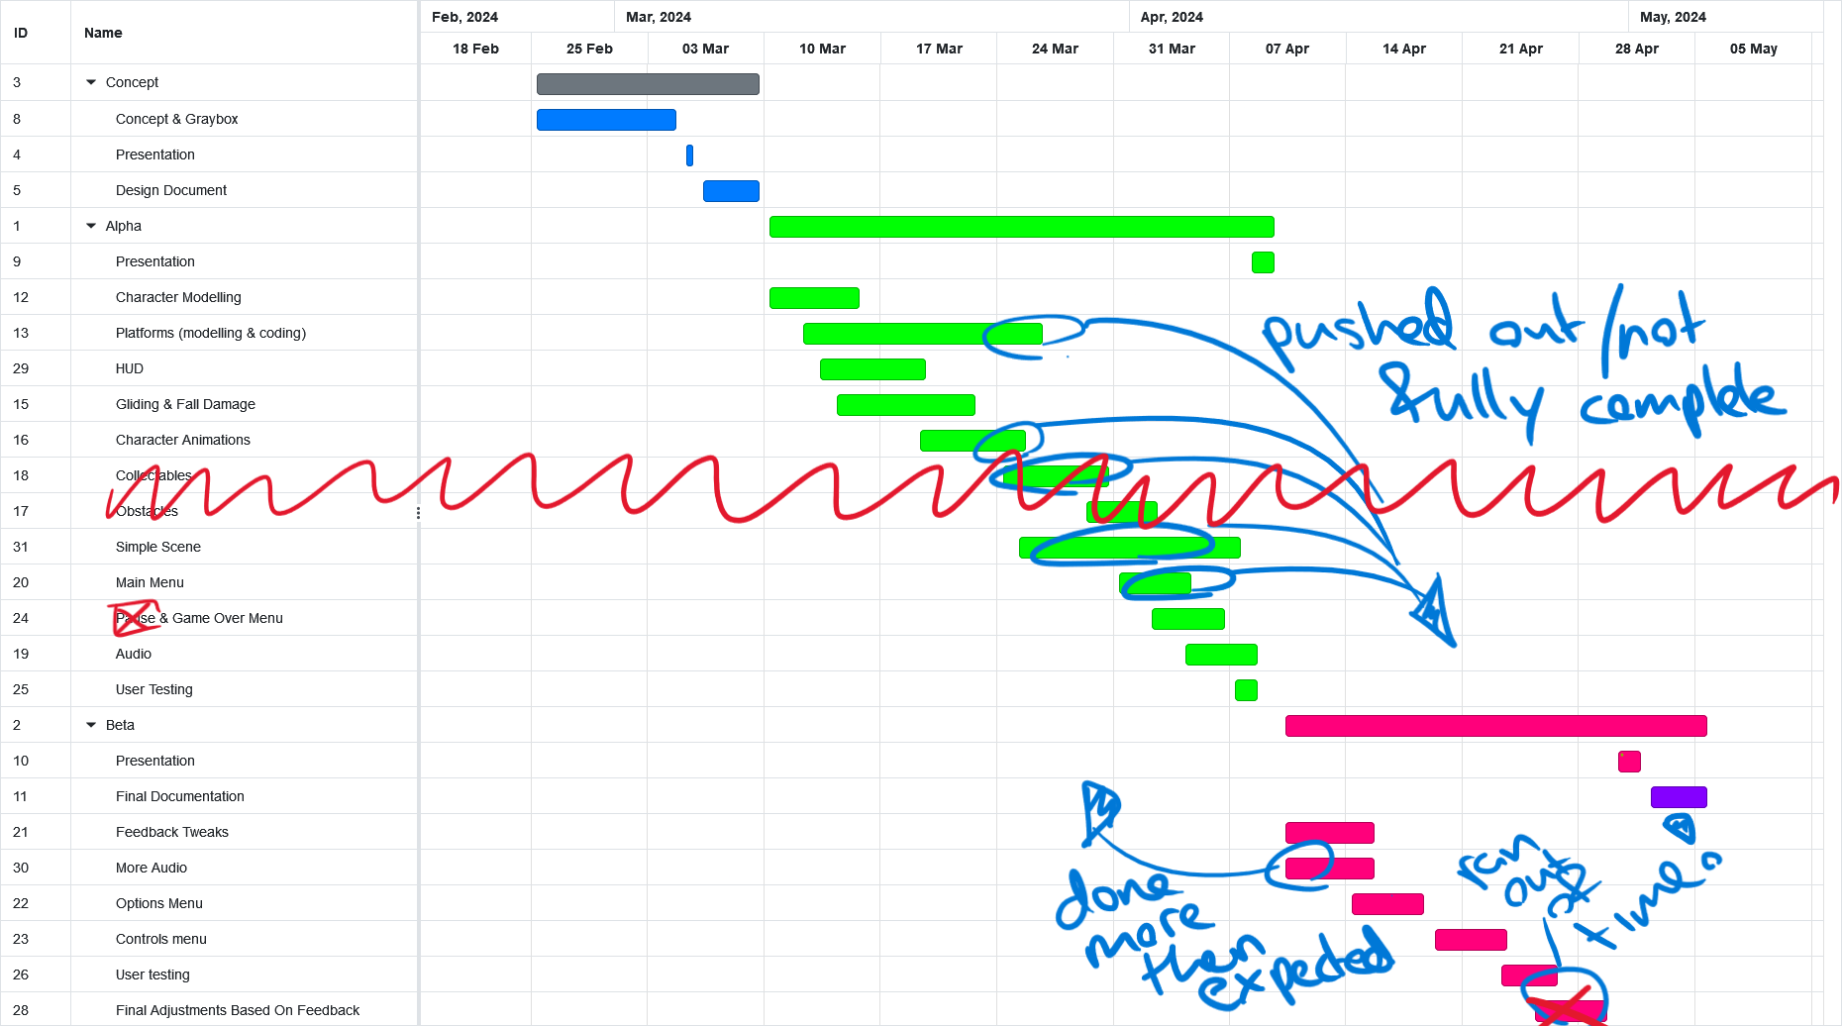
Roadmap

Slide 5
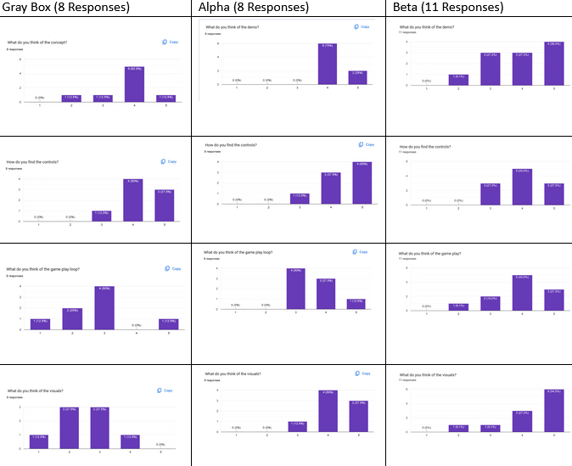
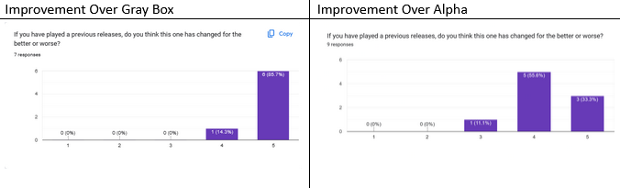
User Testing
Top Beta Score - 2125
Gathered Beta Results too late to change anything
Had more respondents – Some first-time players resulting in a wider range of responses
Things users enjoyed:
Music/Audio
Intuitive controls
Visuals & Atmosphere
Future work based on new feedback:
Powerups – Specifically health boost for balancing purposes as the game is hard
Performance Enhancements - Game is poorly optimized on lower spec hardware (even with lower graphics options)
Option menu has a bug – defaults seem to break when applied
Controller controls are broken in game and don’t work at all in menus.
Lighting is broken on lower graphics settings
Pause menu

Slide 6
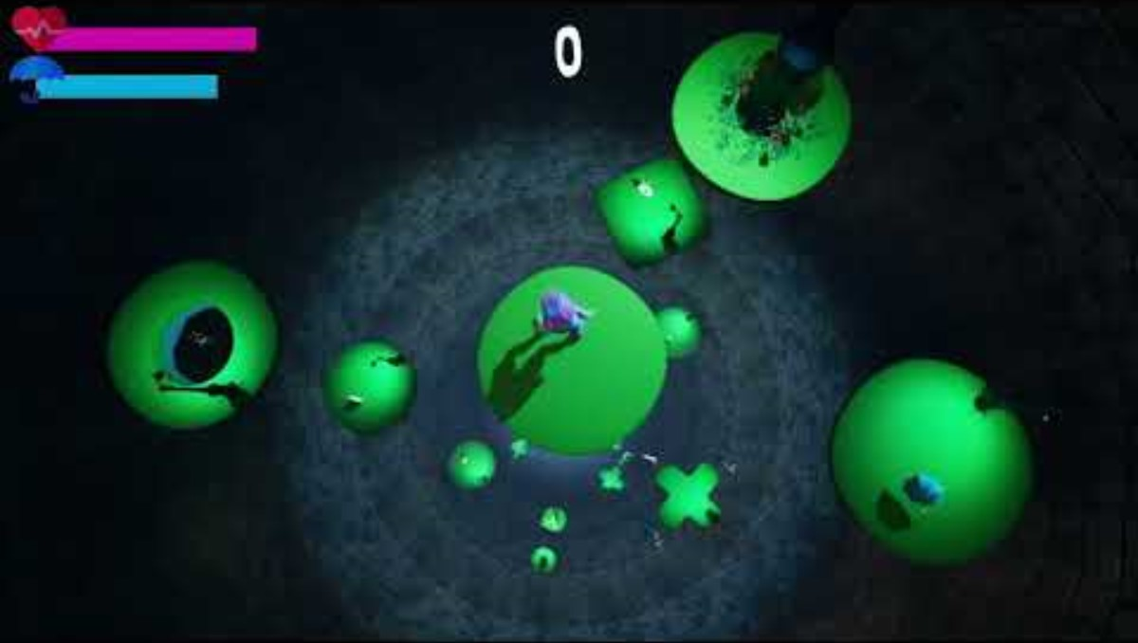
Demo

Slide 7
Questions?

